Slide 1

Team 56: Fall Detection
Sponsor: Krishna Gadepally
ECEN 403 Final Presentation
Justin Haryanto
Nhan Nguyen

Slide 2
Problem Overview
Problem
Design a video-based fall detection system.
Solution
Convert video to a useable images
Apply bounding boxes and key points on people in images using pose estimation
Determine if a fall has occurred using Random Forests and CNN machine learning models

Slide 3
Problem Overview
Video Input
Video Processing
Nhan
Pose Estimation
Justin
Random Forests
CNN
Result Output

Slide 4
Engineering Design Accomplishments
Alphapose successfully processed the fall detection data set for use in the machine learning models
CNN and Random Forest successfully trained on AlphaPose output and produced predictions on if a fall has occurred

Slide 5
Pose Estimation
Mean Average Precision (MAP) is used to examine object detection models.
AlphaPose have a MAP of 75 on the COCO object detection dataset
We seek to improve this performance eventually by retraining AlphaPose
Currently, we have managed to use AlphaPose extract keypoints and bounding boxes from our data

Slide 6
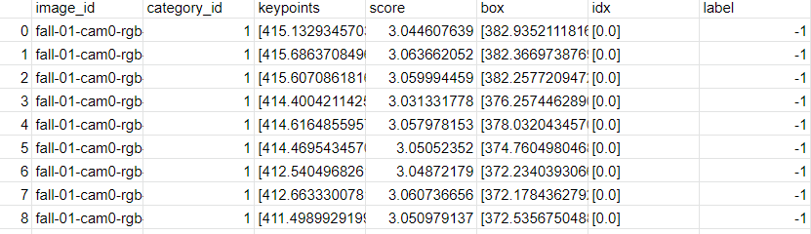
Pose Estimation Results
The keypoint and bounding box results from AlphaPose.
Results From AlphaPose

Slide 7
Fall Detection Subsystem
ML models are being trained and validated using key points and bounding boxes data collected so far.
Key points information shows potential
 | Random Forest | CNN
Accuracy on Small Data Set | 100% | 26%

Slide 8
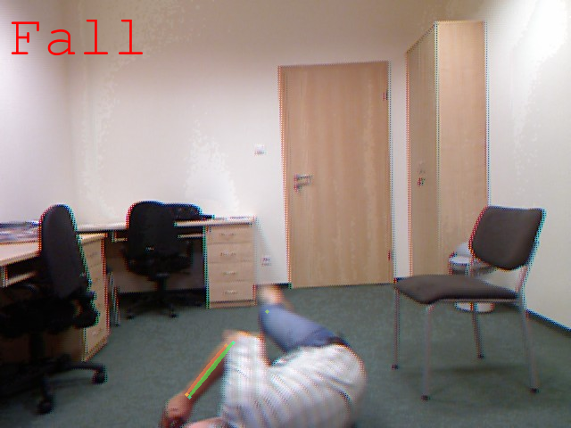
Fall Detection Subsystem

Slide 9
Execution plan
Completed
In Progress
Not Started
Goal | 9/5 | 9/19 | 10/3 | 10/17 | 10/31 | 11/14 | 11/28
Review Literature on Pose Estimation (Both)
Experiment with Pose Estimation programs (Nhan)
Improve Performance of Pose Estimation Programs (Nhan)
Practice Machine Learning (Justin)
Fall Detection Dataset (Both)
Train Fall Detection (Justin)

Slide 10
Validation plan
Test | Success Criteria | Methodology | Status | Responsibility
Pose Estimation FPS | Processes videos at 30 FPS | Feed videos at various FPS | Testing | Nhan Nguyen
Pose Estimation Performance | MAP is greater than 70+ mAP on COCO dataset | Training AlphaPose with new data | Testing | Nhan Nguyen
Fall Detection Accuracy | >90% of falls successfully detected | Use processed videos, compare to labelled dataset | Testing | Justin Haryanto
Fall Detection CNN Accuracy | >90% of fall images and bounding boxes successfully detected | Use fall images and bounding boxes, compared to labelled dataset | Testing | Full Team
Fall Detection Random Forest Accuracy | >90% of fall keypoints successfully detected | Use key points, compared to labelled dataset | Testing | Justin Haryanto
Whole System Accuracy | >90% of falls successfully detected | Use raw videos, compare to labelled dataset | Untested | Full Team

Slide 11
Remaining Tasks
For Demo
Test with video for Pose Estimation subsystem
Combine Pose Estimation and Fall Detection systems
Improve Random Forest and CNN accuracy
More training on current data set
For 404
Improve performance of Pose Estimation and Fall Detection Systems
Run with live video
Training on larger, diverse data sets

Slide 12
Thank You

